Slide 1
Remote Medical Information System
Zhaoyangzhu and Chenyu Tian

Slide 2
Background
Remote Medical Information System is a system that record patient information. Users can remotely access the database through the network.
Users can access or modify the database remotely by sending requests to the server using TCP.
Multiple users can access the server at the same time.
Multiple users can also access the same database at the same time.
The system provides a GUI to help users use the system.

Slide 3
Some Operation of MIS
Enter a new patient：
When a user creates new patient information, the system provides the user with a menu to obtain profile information. The system then sends a message to the user indicating that the user was created successfully.
Delete a patient：
The user can choose to delete the patient information on the last name and birthday page of the patient information. When the deletion is successful, the system will send a message to the user.
Find and display a Patient：
Users can search for a specific patient through the system and display patient details.

Slide 4
Some Operation of MIS
Modify a patient profile：
The user is eligible to make changes to the patient's first name, last name, address, phone number, insurance type, co-payment, and patient type.
Search the database：
The user can search for patient information by attribute (physician, insurance, type, allergy, illness), and the system will prompt for a value for that attribute. The feature will display the names and phone numbers of patients who match the search criteria, but not the patient's profile.
The database will automatically save when the user close the system.

Slide 5
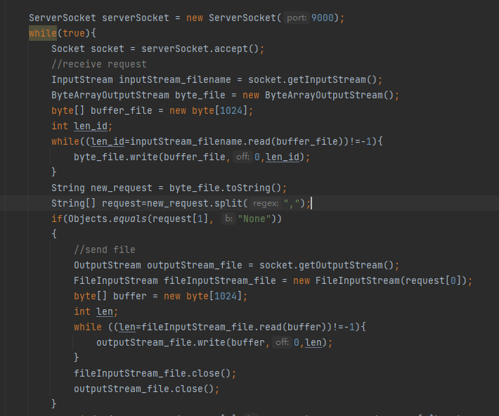
Requesting a File
server

Slide 6
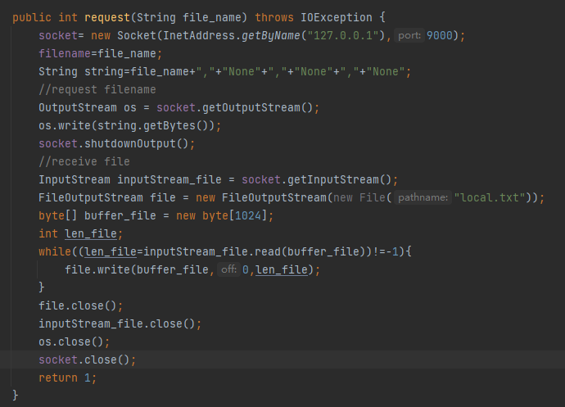
Requesting a File
client

Slide 7
connection between the server and the user
user
request file
server
user
send file
modification request
server
user
send OK or Fail
If the user wants to access a database on the server, the system will request a file by sending a filename to the server. And then the server returns the file to the user. Then the user might modify the database by sending requests to server, and the server returns “OK” or “Fail” to the user.

Slide 8
We also added a lock to each database to prevent multiple users from modifying one database at the same time.
When the user sends a request to modify the database, the server first checks whether the lock is available. If the hold is available, the server will send "OK" and give the lock to the user.
After finishing the request the server will release the lock.
If the lock is unavailable, the server will send "Fail" to the user to notify the user that the database is currently modifying by another user.

Slide 9
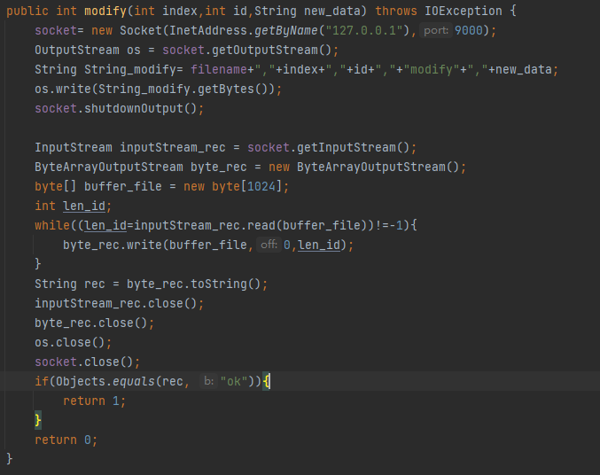
Modifying the Database
client

Slide 10
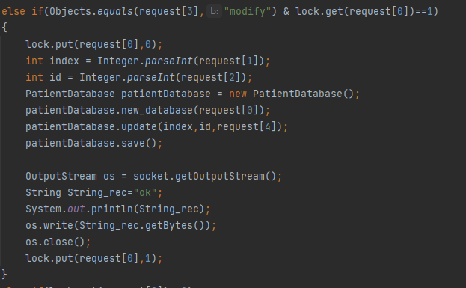
Modifying the Database
server

Slide 11
Different Modules in the System
MIS_socket.java
MIS_socket.java is used to sent different requests to the server.
server.java
server.java is used to handle different requests from the user.
GUI.java
GUI.java provides a user interface.
PatientDatabase.java
A data container class for Patient.
Patient.java
A class contains attributes of a patient.
MedicalConditions.java
A class contains attributes of medical conditions of a patient.

Slide 12
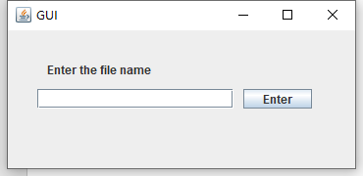
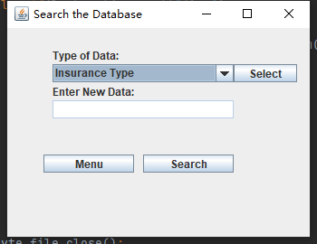
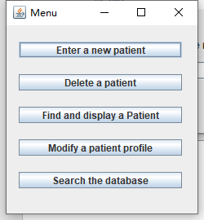
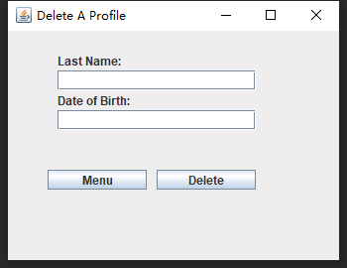
User Interface

Slide 13
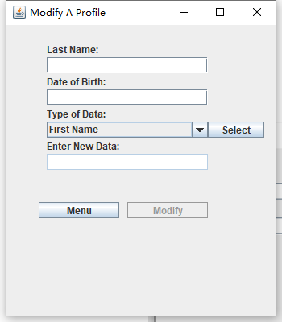
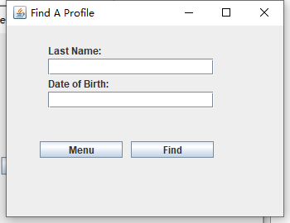

Slide 14
Thank You!

